Slide 1





LIPID MAPS Lipidomic Gateway Workshop
Maria Valdivia-Garcia
Cardiff University, United Kingdom
Leipzig, March 21st
2019

Slide 2
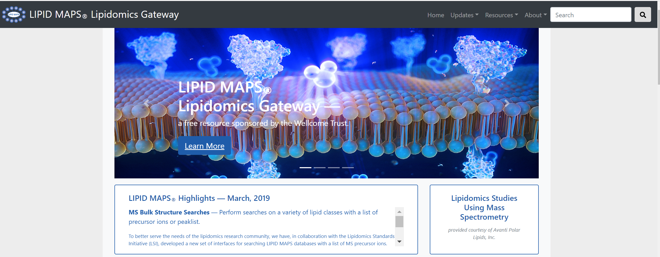
^{https://www.lipidmaps.org}
Cardiff University, UK Babraham Institute, UK (2018-currently)
UCSD (2003-2018)

Slide 3
^{Lipids}
http://www.lipidmaps.org/resources/tutorials/index.php
hydrophobic or amphiphilic small molecules that originate entirely or in part from two distinct types of biochemical subunits or "building blocks": ketoacyl and isoprene groups..
Fahy,E. et al, Journal of Lipid Research, Vol. 46, 839-862, May 2005
Fundamental biosynthetic units of lipids

Slide 4
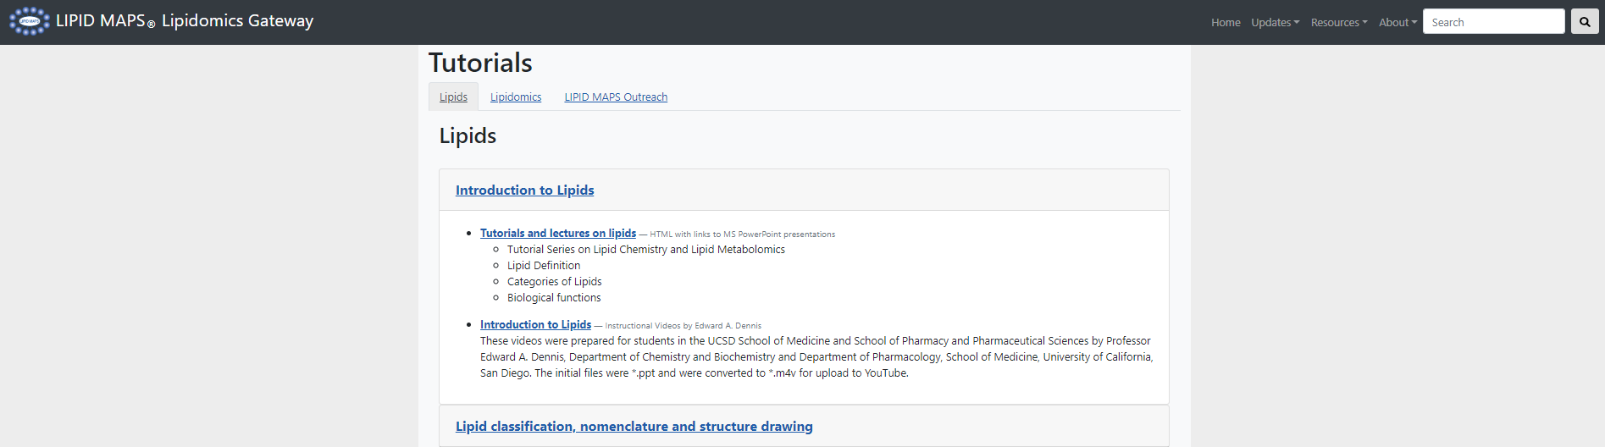
Tutorials and Lectures on Lipids
http://www.lipidmaps.org/resources/tutorials/index.php

Slide 5
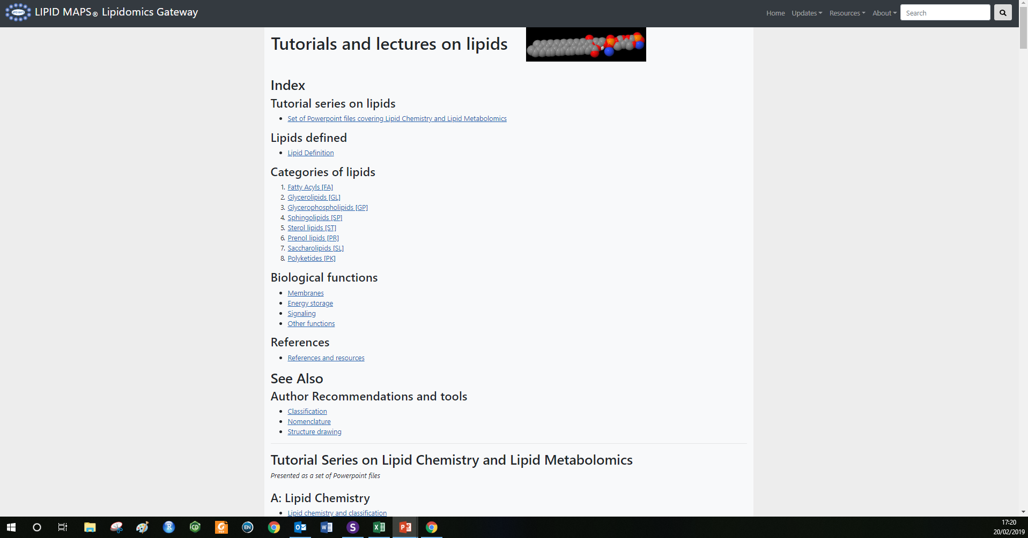
^{Lipids Tutorials}
http://www.lipidmaps.org/resources/tutorials/lipid_tutorial.html

Slide 6
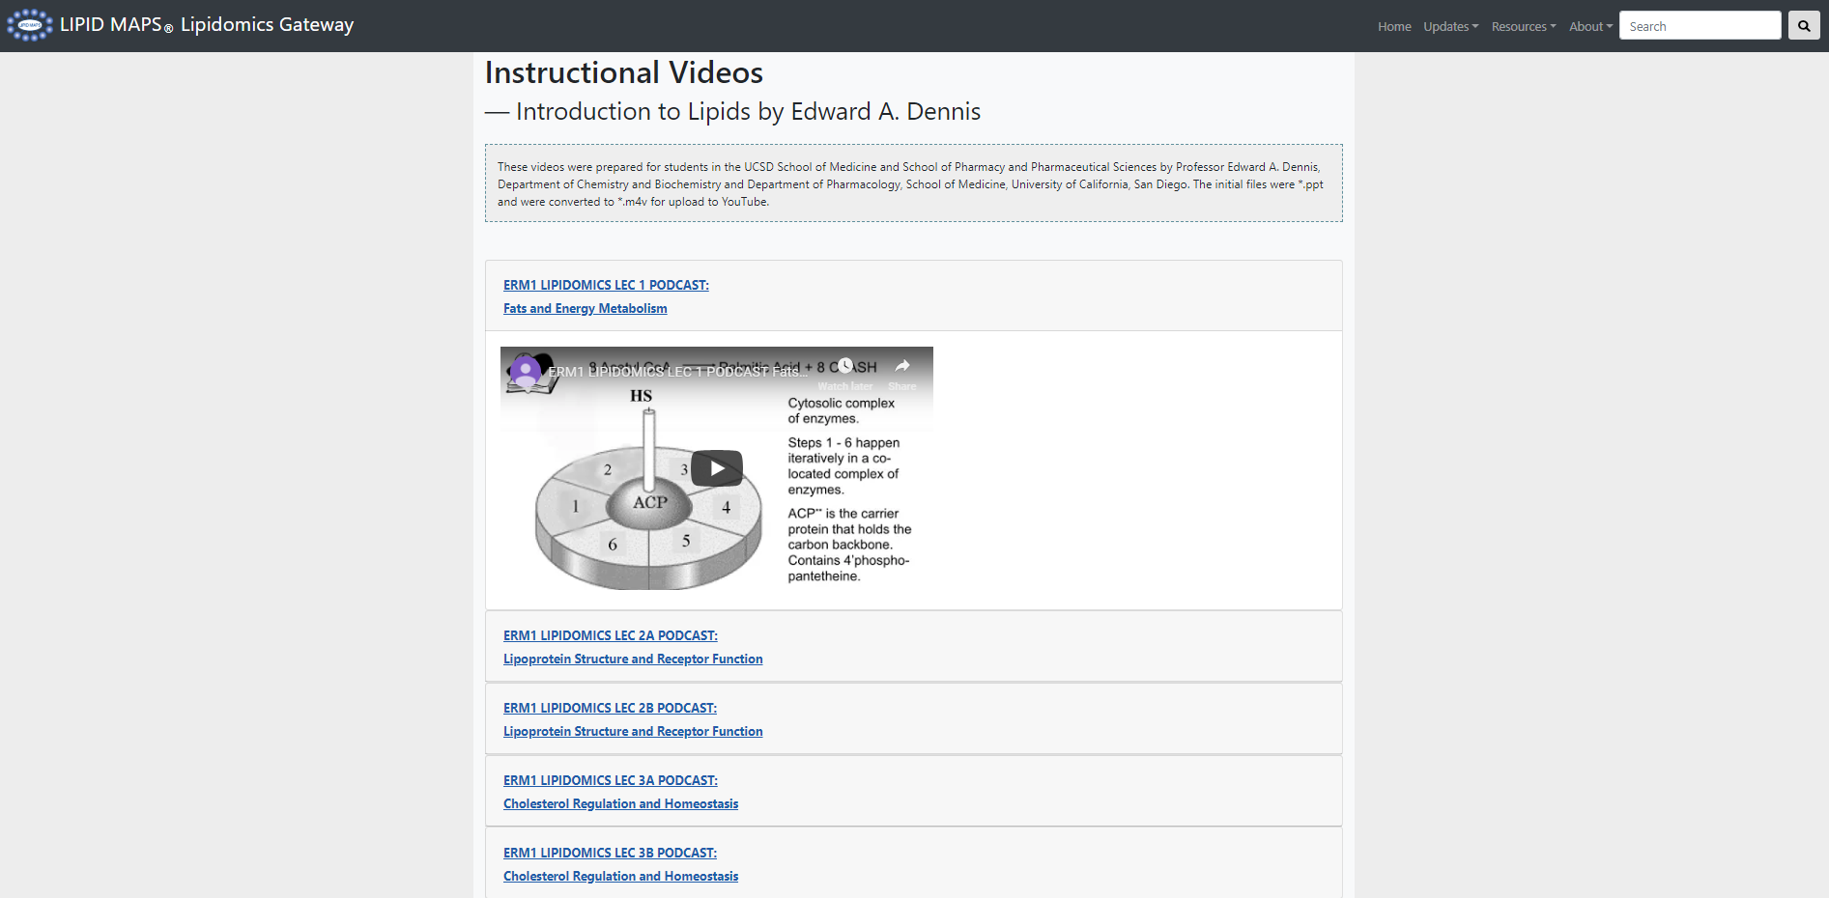
^{Lipids Tutorials}
http://www.lipidmaps.org/resources/tutorials/dennis_lipids_intro.php

Slide 7
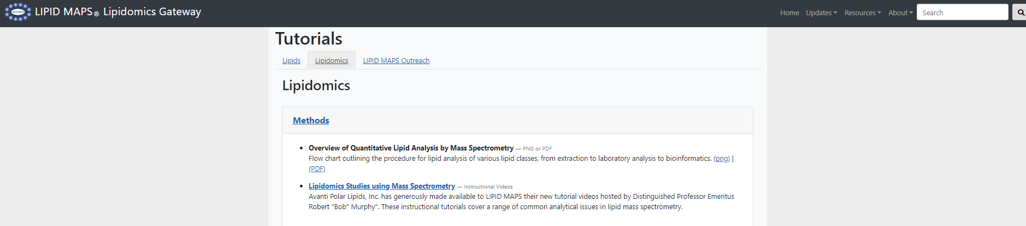
^{Lipids Tutorials}
http://www.lipidmaps.org/resources/tutorials/index.php?tab=tab2

Slide 8
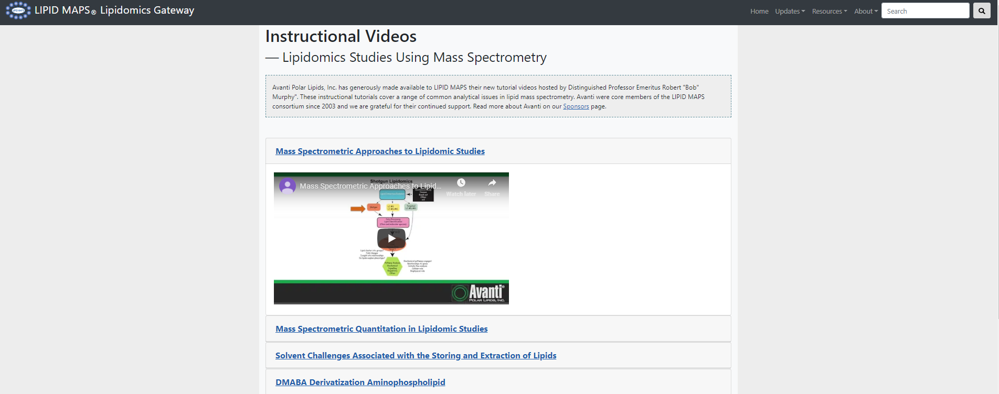
^{Lipids Tutorials}
http://www.lipidmaps.org/resources/tutorials/videos.php

Slide 9
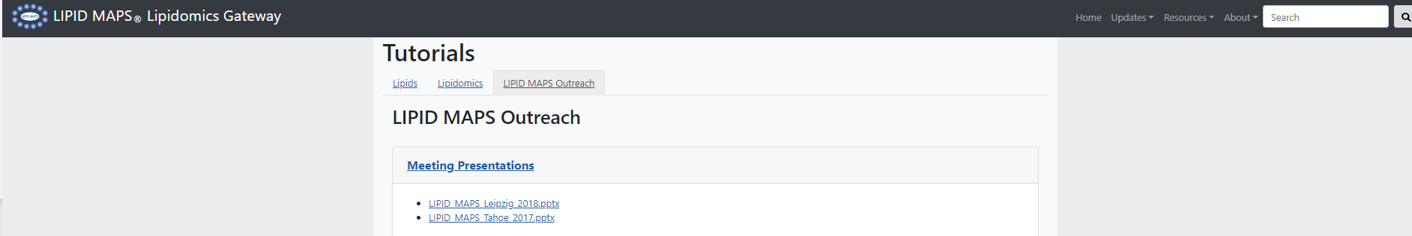
^{Lipids Tutorials}
http://www.lipidmaps.org/resources/tutorials/index.php?tab=tab3

Slide 10
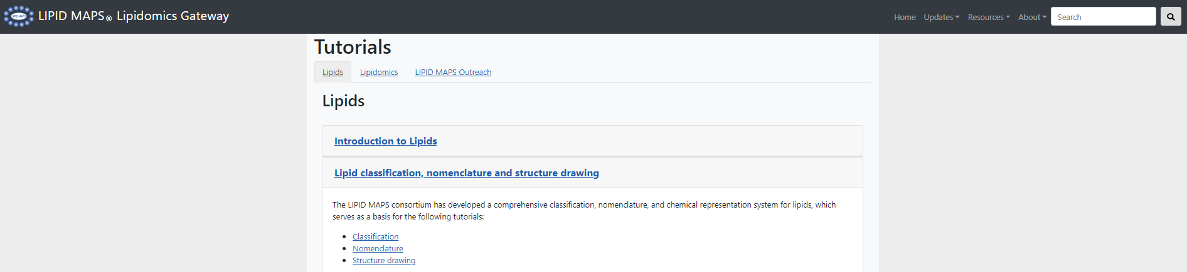
Lipids Tutorials: Classification, nomenclature and structure drawing
http://www.lipidmaps.org/resources/tutorials/index.php?tab=tab1

Slide 11
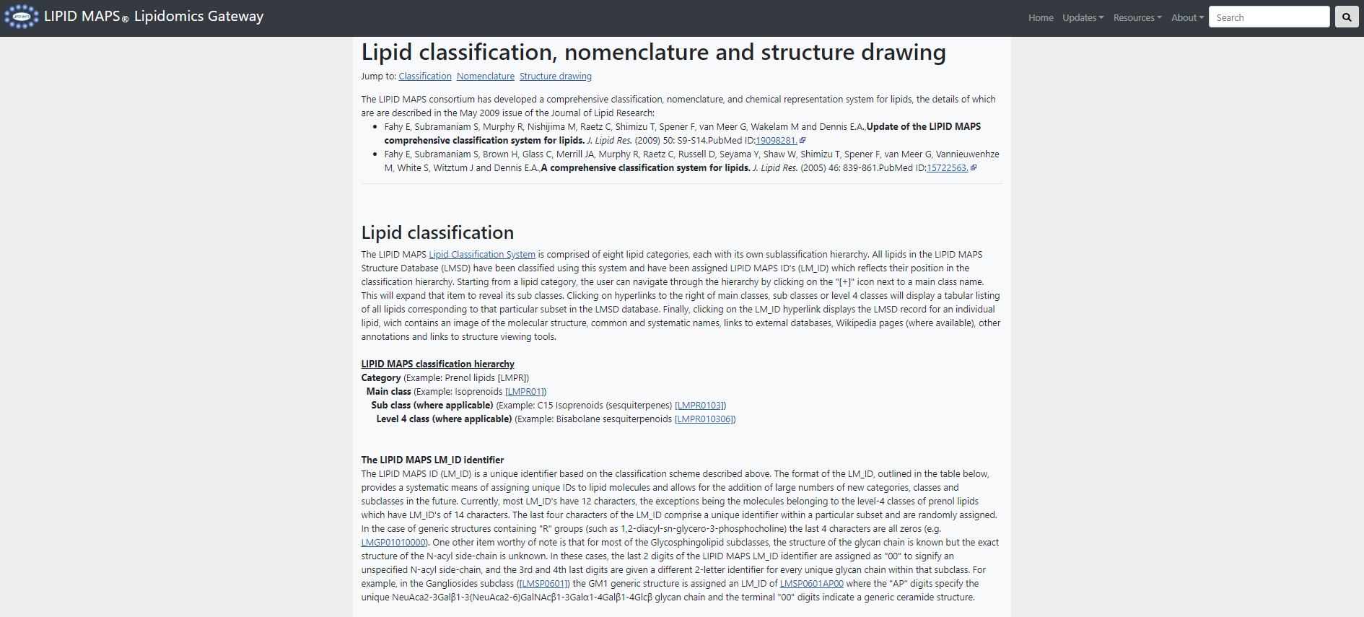
Lipids Tutorials: Classification, nomenclature and structure drawing
http://www.lipidmaps.org/resources/tutorials/lipid_cns.html#C

Slide 12
Lipids Tutorials: Classification, nomenclature and structure drawing
http://www.lipidmaps.org/resources/tutorials/lipid_cns.html#C
Category | Abbreviation
Fatty acyls | FA
Glycerolipids | GL
Glycerophospholipids | GP
Sphingolipids | SP
Sterol lipids | ST
Prenol lipids | PR
Saccharolipids | SL
Polyketides | PK

Slide 13
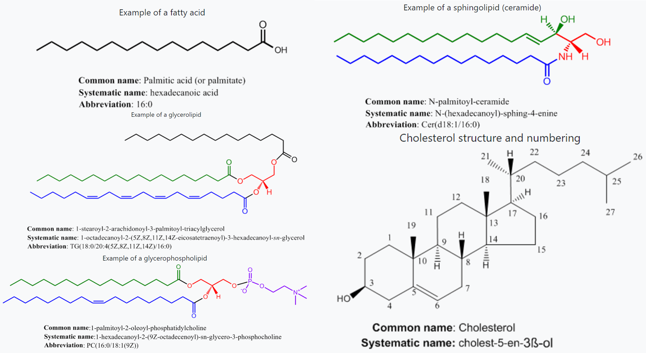
LIPID MAPS Classification System
Categories and Examples

Slide 14
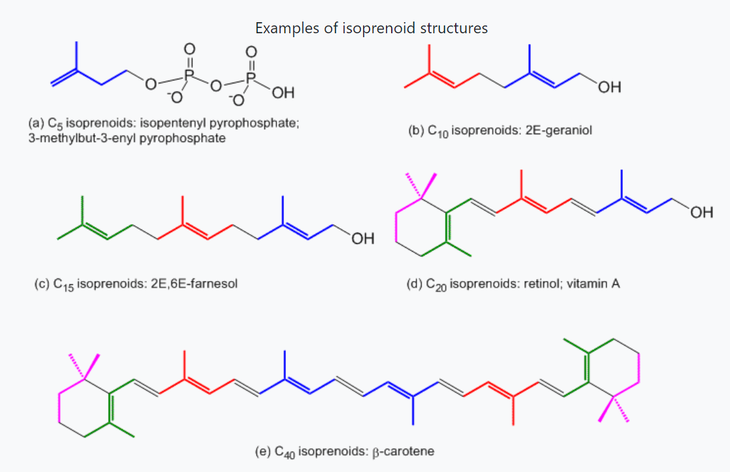
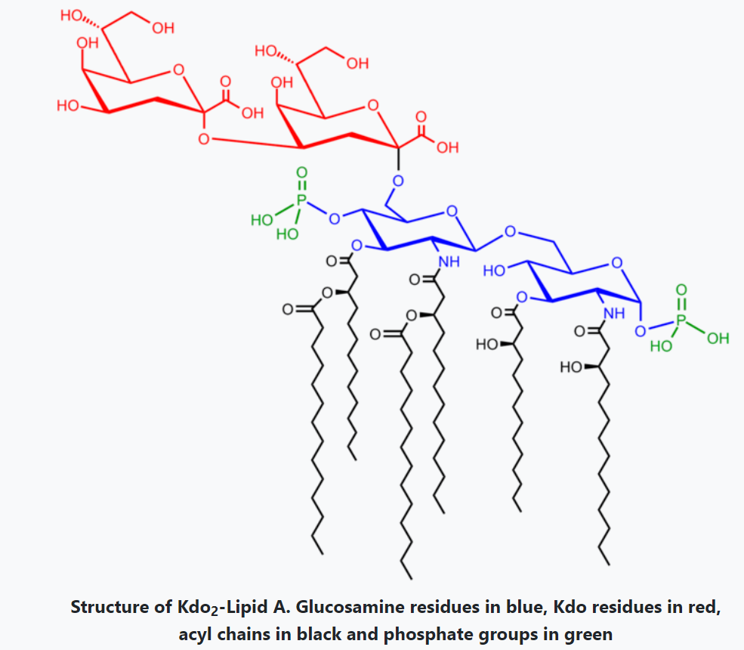
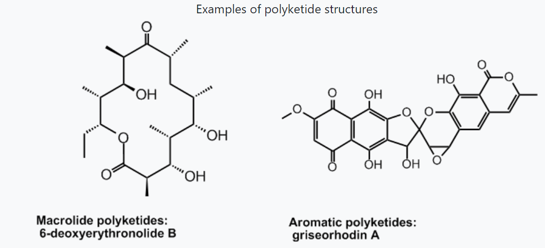
LIPID MAPS Classification System
Categories and Examples

Slide 15
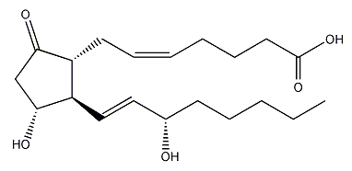
LIPID MAPS Classification System/ Hierarchy and LM_ID identifier
Name: PGE₂
LIPID MAPS ID: (LM_ID) Hierarchy
Category: FA (Fatty Acyls) [LMFA]
Main Class: 03 (Eicosanoids) [LMFA03]
Sub Class: 01 (Prostaglandins) [LMFA0301]
Unique identifier within a sub class: [LMFA03010003]

Slide 16
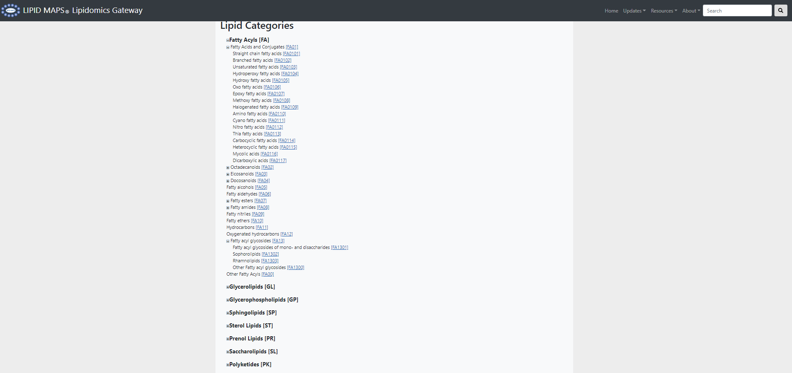
Lipids Tutorials: Classification
http://www.lipidmaps.org/data/classification/LM_classification_exp.php

Slide 17
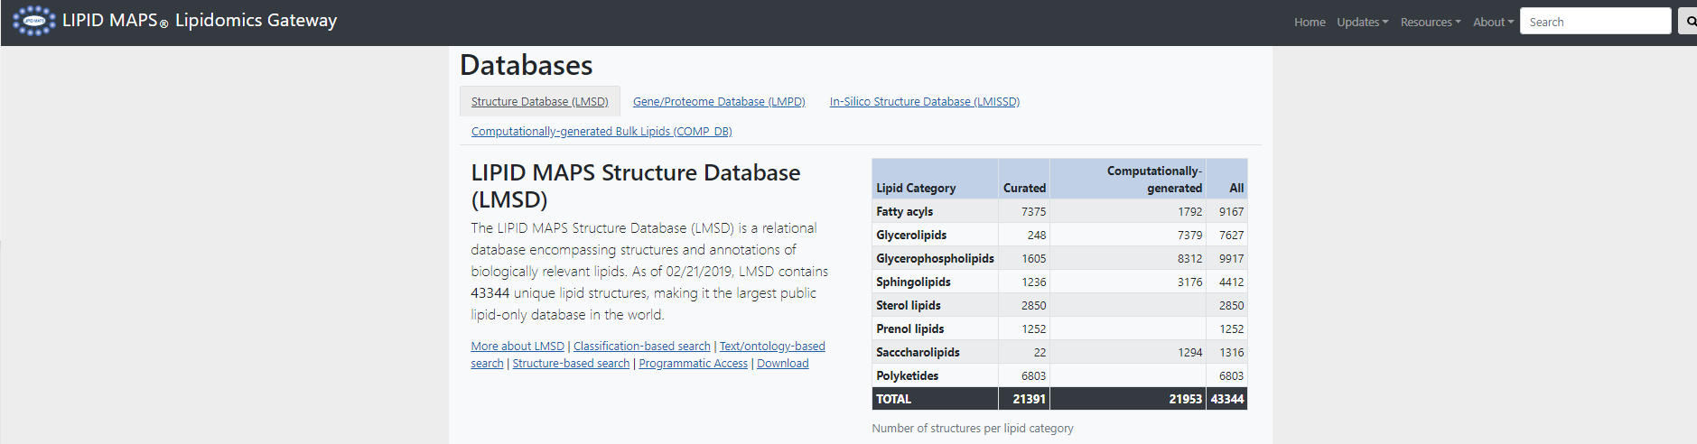
^{Databases}
http://www.lipidmaps.org/resources/databases/index.php
Over 43,000 classified structures as of 9/20/2018
Full structures in multiple formats, exact mass and inline m/z features
Relevant database cross references, InChIKey values for each structure
Calculated physicochemical properties added for each structure
Links to internal/external MS data
Ongoing screening of major lipid-related journals

Slide 18
^{LIPID MAPS Gateway Databases}
http://www.lipidmaps.org/resources/databases/index.php
Gene/ Proteome
Database (LMPD)
LIPID MAPS Structure Database (LMSD)
Computationally generated Bulk Lipids (COMP_DB)
In-Silico Structure Database (LMISSD)

Slide 19
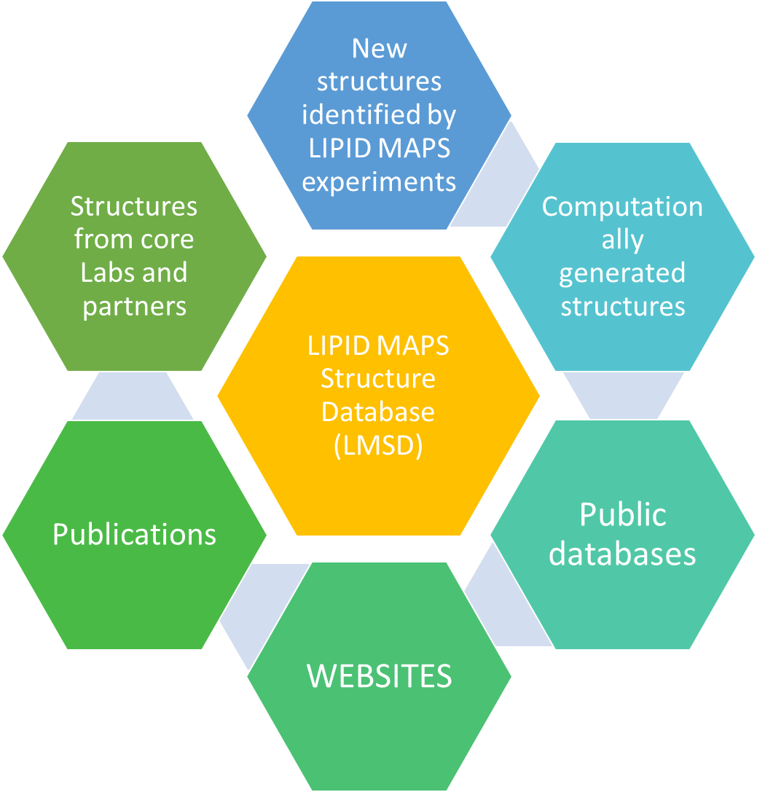
LIPID MAPS Gateway Composition and curation of LMSD
Curation

Slide 20
^{LIPID MAPS Gateway Databases}
http://www.lipidmaps.org/resources/databases/index.php
LIPID MAPS Structure Database (LMSD)
43,344
Comp.
generated
Bulk Lipids
21,953
562
Curated
Lipids
21,391

Slide 21
Number of Structures per Lipid Category
CURATED

Slide 22
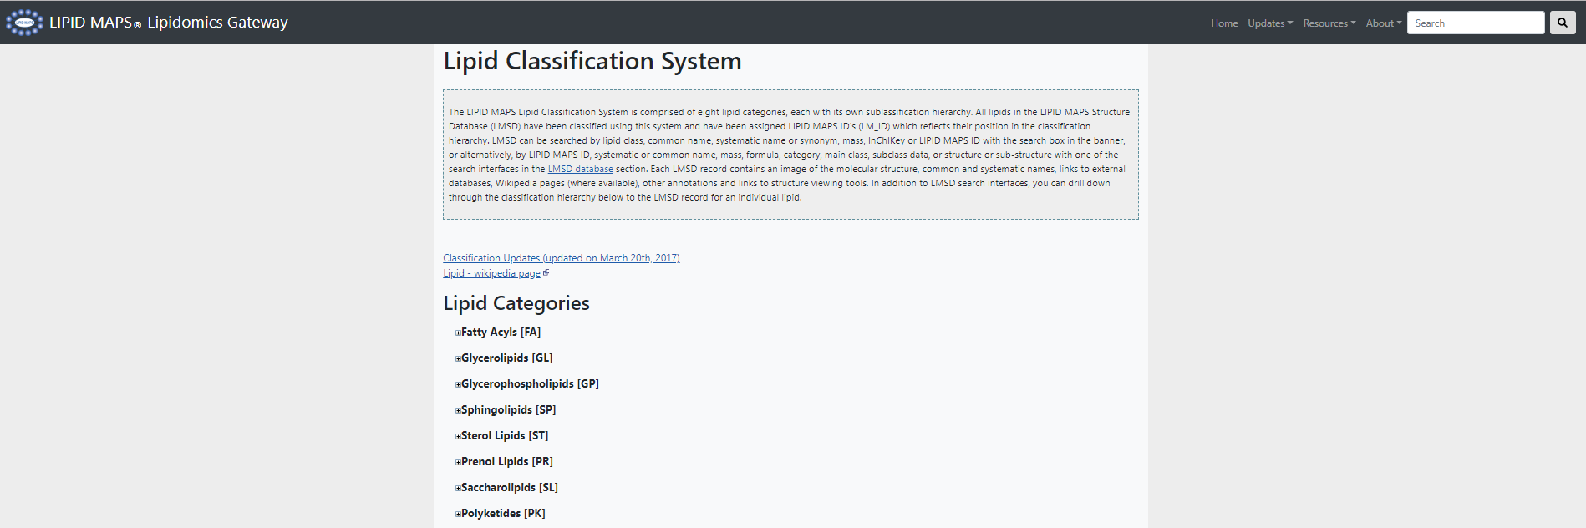
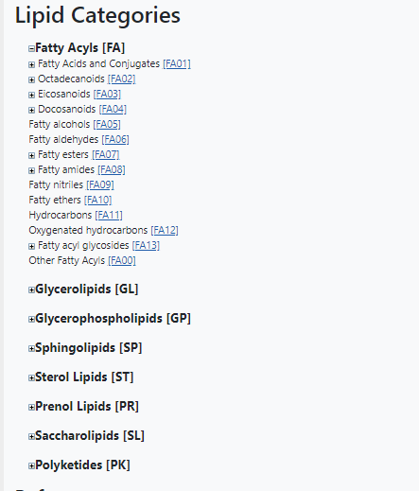
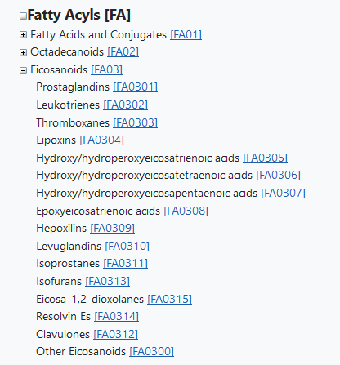
Search LMSD by browsing classification hierarchy http://www.lipidmaps.org/data/classification/LM_classification_exp.php

Slide 23
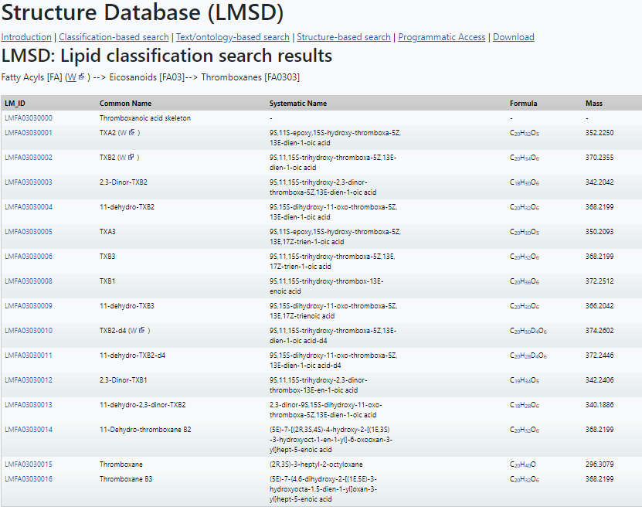
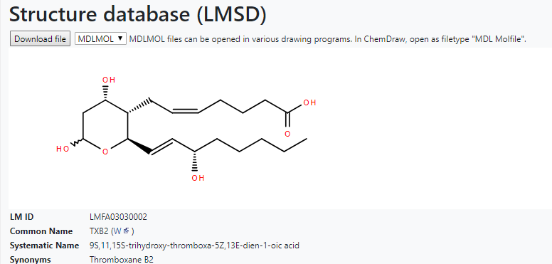
Search LMSD by browsing classification hierarchy

Slide 24
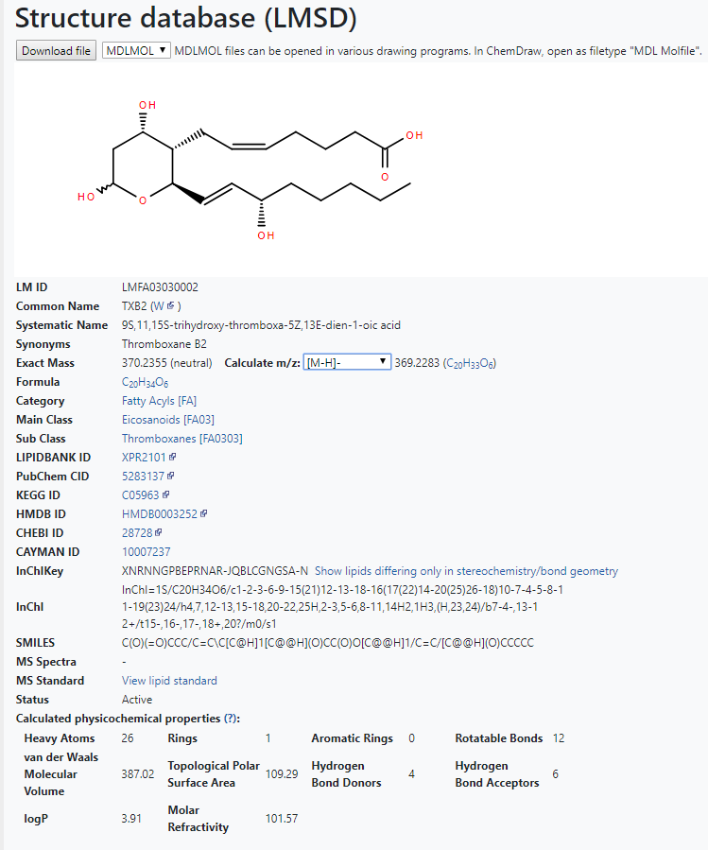
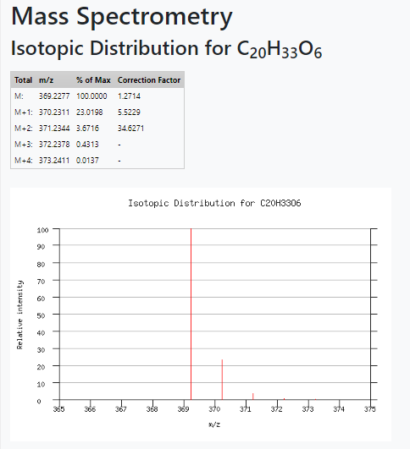
LMSD: m/z calculator
m/z for selected ion type/adduct
Lipid classification
Database cross-references
InChiKey identifier

Slide 25
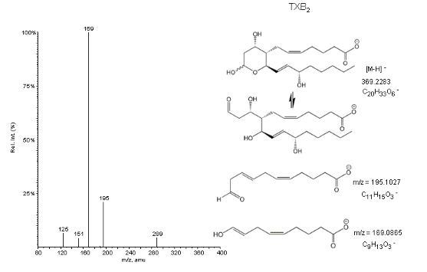
MS/MS: 369[M-H]⁻

Slide 26
Use InChIKey to find structures differing only in stereochemistry, double-bond geometry or isotopic labeling

Slide 27
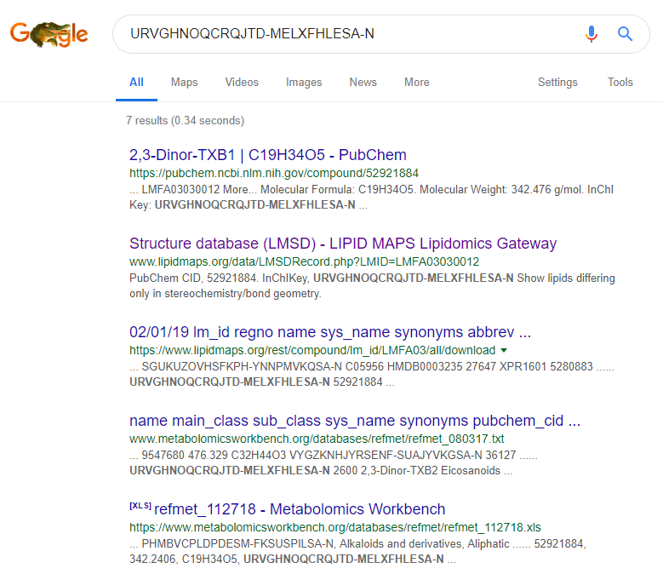
Use InChIKey to find structures online search engine
https://pubchem.ncbi.nlm.nih.gov
https://lipidmaps.org

Slide 28
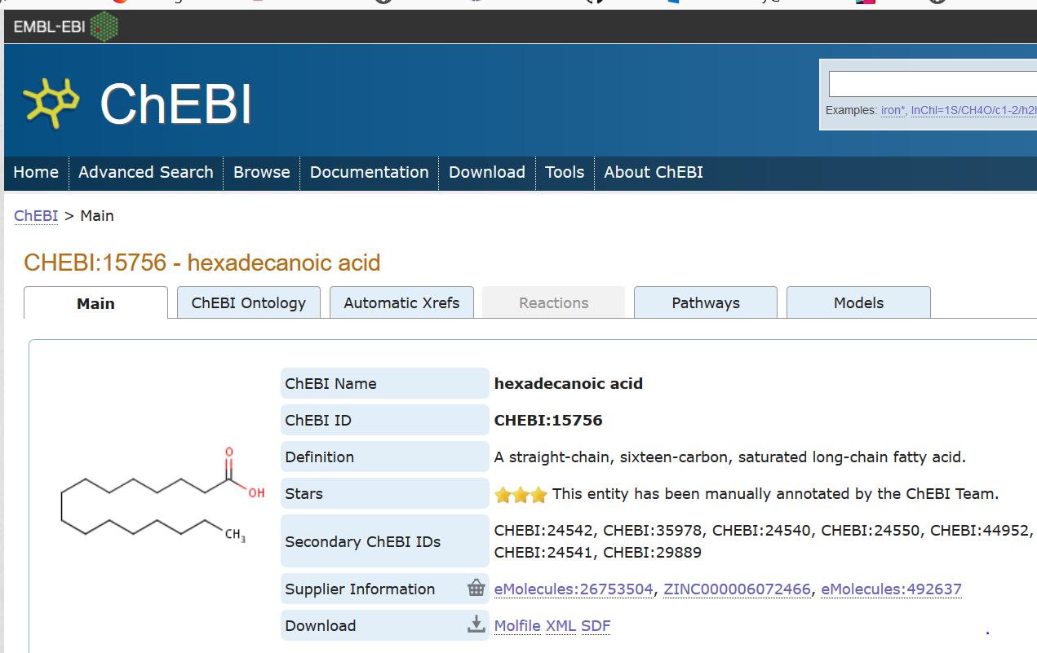
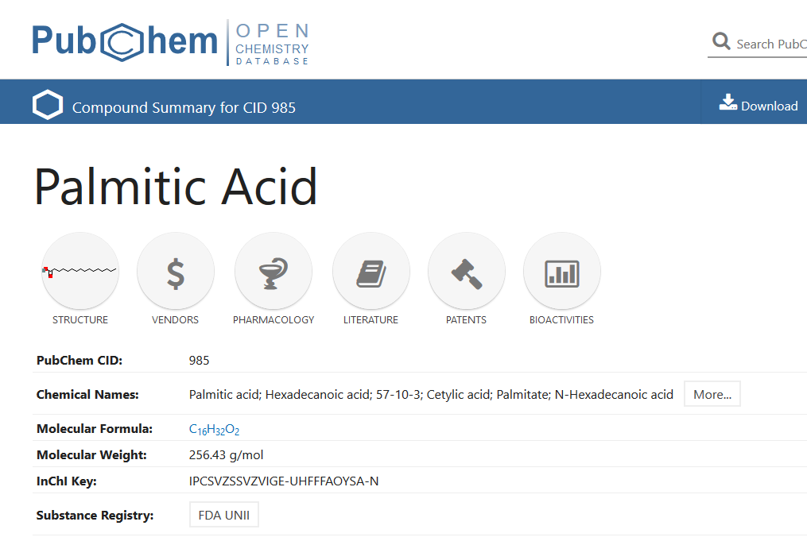
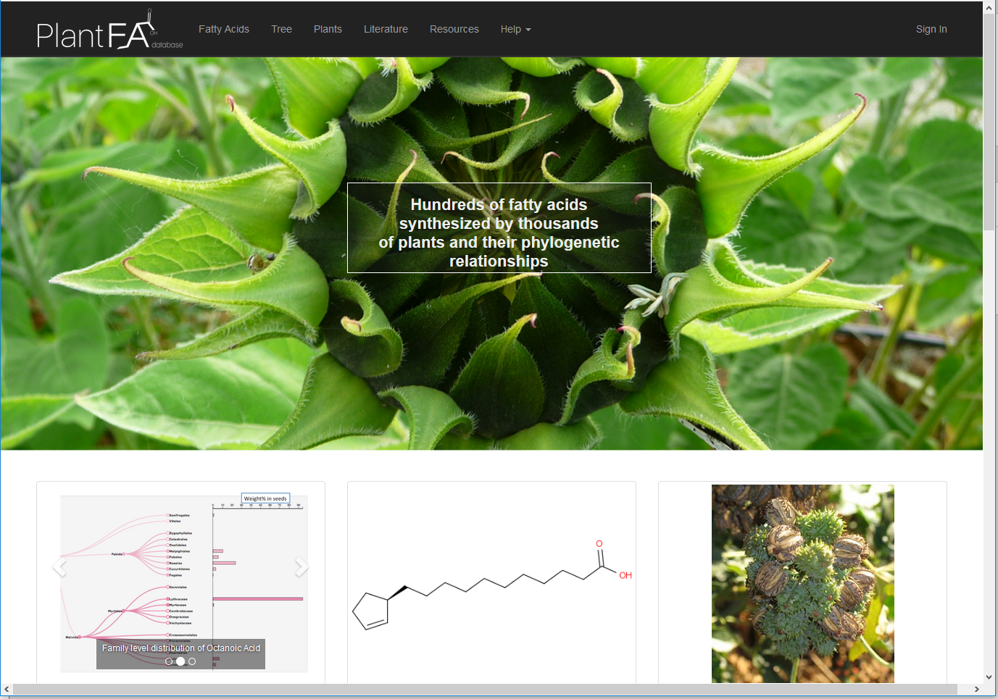
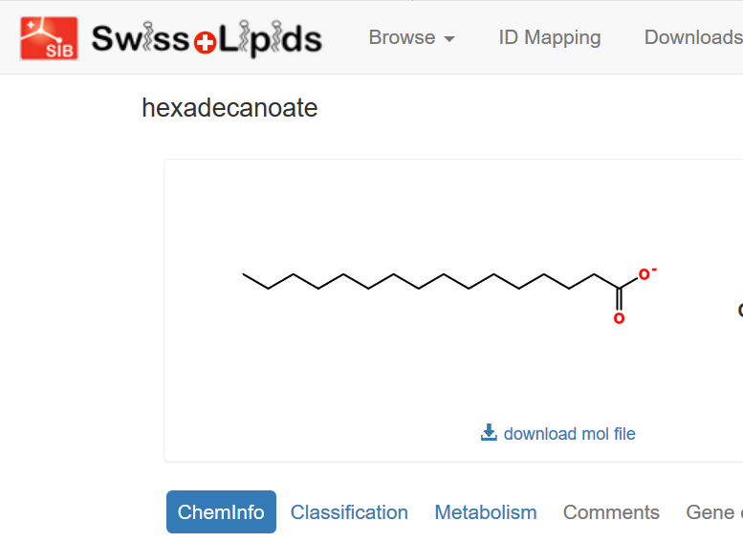
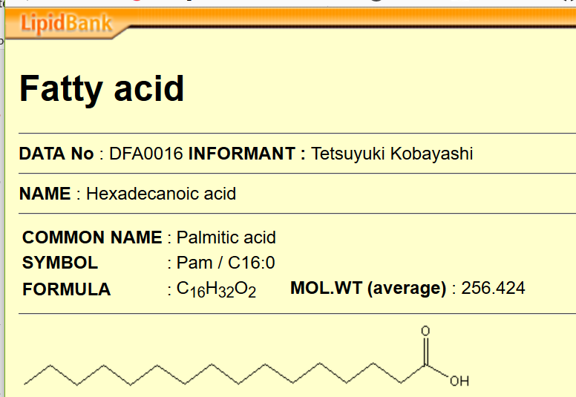
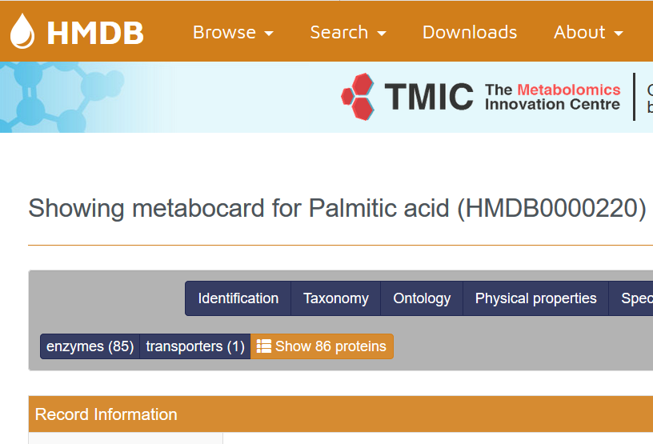
Linking LMSD to other structure databases and resources
ChEBI
PubChem
Plant FattyAcid db
SwissLipids
LipidBank
HMDB

Slide 29
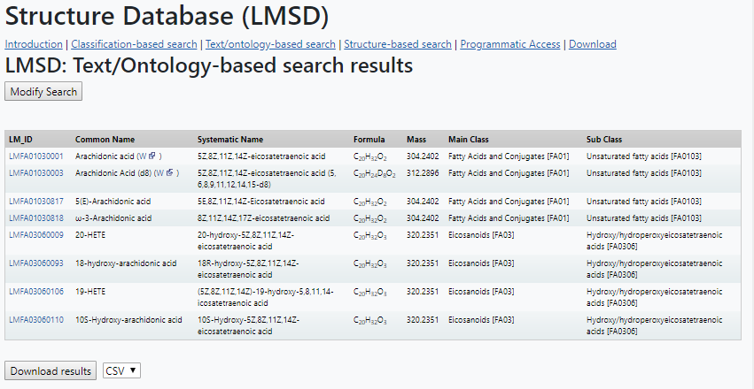
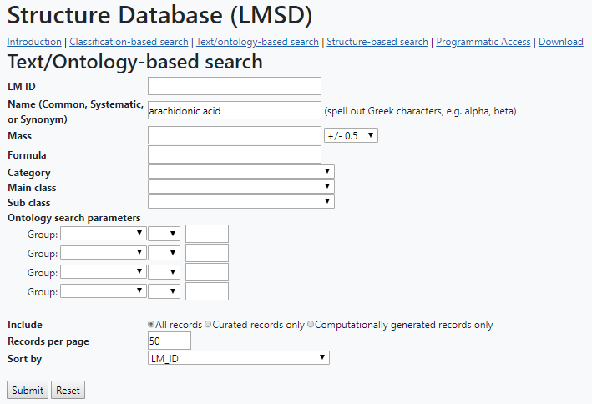
Text/ontology-based search
Resources →Databases -> Text/ontology
AA: 303.2321 [M-H]
12-HETE: 319.2275 [M-H]
Thromboxane: 351.2176 [M-H]
18:0a/20:4-PE 766.5385 [M-H]
18:0a/20:4-PC 810.6007 [M+H]
16:0a/20:4-PC 782.5678 [M+H]

Slide 30
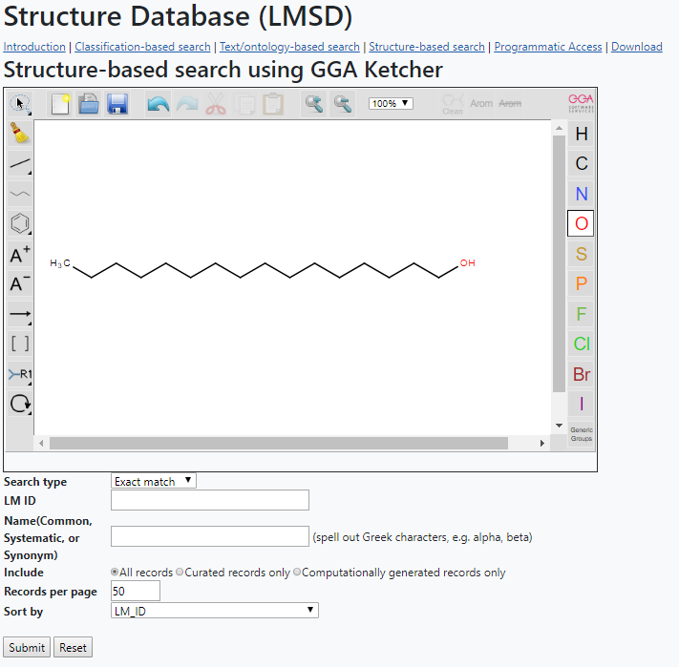
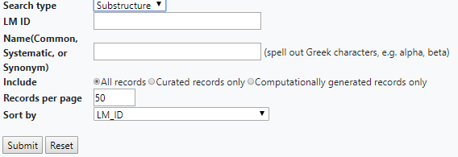
Structure-based search
Resources →Databases -> Structure-based search
If Exact match is not selected, then Substructure selection will produce several hits

Slide 31
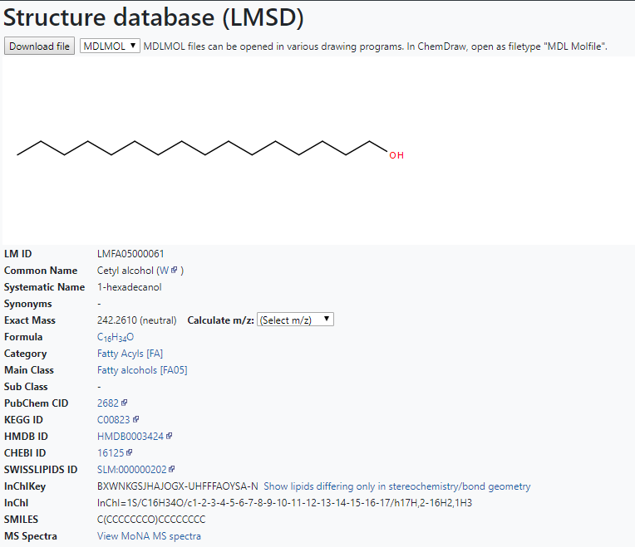
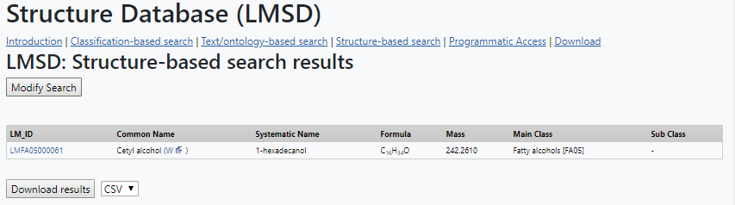
Structure-based search
Resources →Databases -> Structure-based search

Slide 32
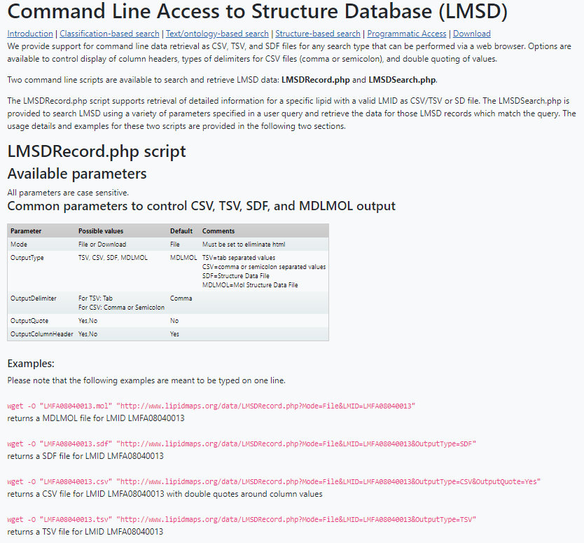
Programmatic access search
Resources →Databases -> Programmatic access
http://www.lipidmaps.org/data/LMSDRecord.php?Mode=Download&OutputType=CSV&LMID=LMFA08040013
http://www.lipidmaps.org/data/LMSDRecord.php?Mode=Download&OutputType=MDLMOL&LMID=LMFA08040013

Slide 33
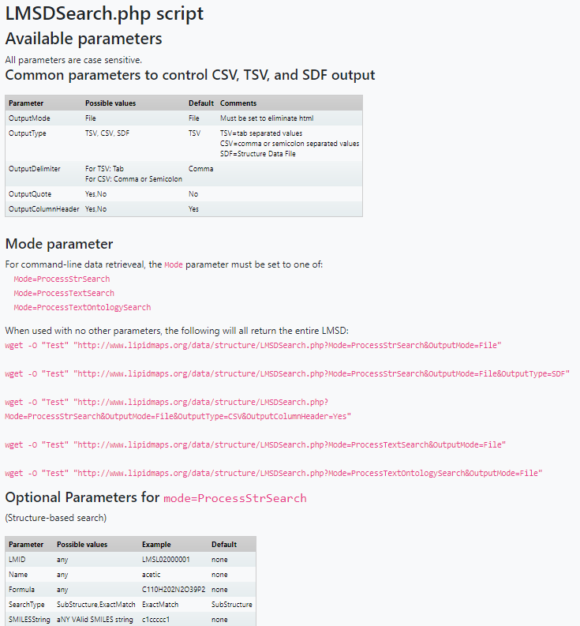
Programmatic access search
Resources →Databases -> Programmatic access
http://www.lipidmaps.org/data/structure/LMSDSearch.php?Mode=ProcessTextSearch&OutputMode=File&CoreClass=1
(returns all fatty acids)
http://www.lipidmaps.org/data/structure/LMSDSearch.php?Mode=ProcessTextSearch&OutputMode=File&CoreClass=1&MainClass=101&SubClass=10101
(returns all straight chain fatty acids)

Slide 34
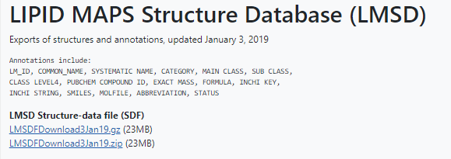
Downloading LIPID MAPS Structure Database (LMSD)
Resources →Databases -> Download

Slide 35
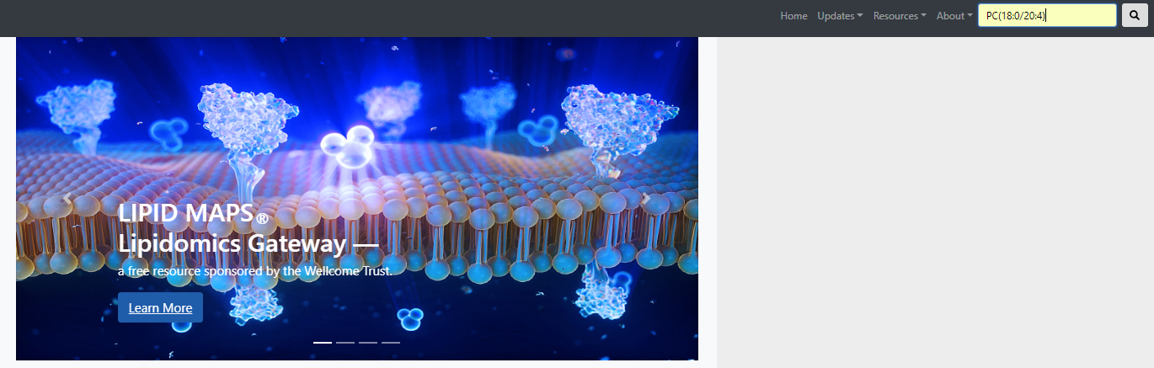
Querying Lipidomics Gateway website as “Quick search”
lipid class, common name, systematic name or synonym, mass, formula, InChIKey, LIPID MAPS ID, gene or protein term.

Slide 36
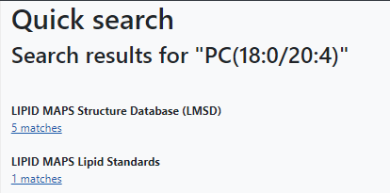
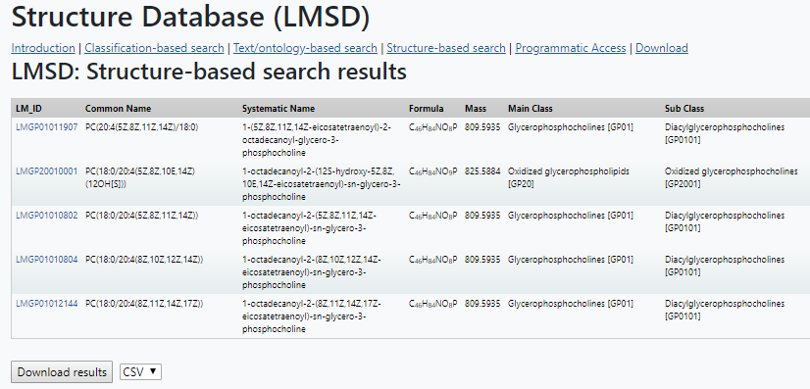
Querying Lipidomics Gateway website as “Quick search”

Slide 37
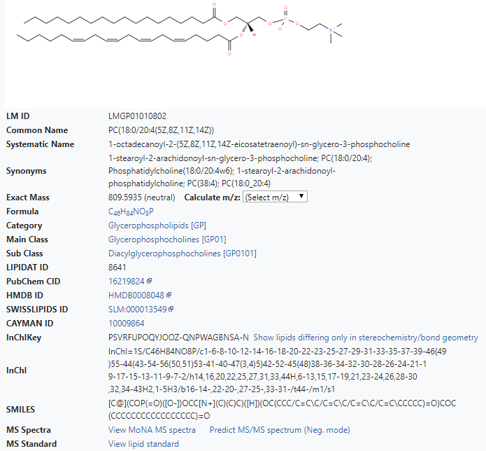
Querying Lipidomics Gateway website as “Quick search”
MoNA: Mass Bank of North America
From LIPID MAPS

Slide 38
Curated and annotated MS/MS spectra of lipid standards contributed by LIPID MAPS core labs
Massbank of North America (MoNA) repository at UC Davis. Contains both experimentally obtained and predicted (LipidBlast) spectra
Predicted MS/MS spectra using LIPID MAPS algorithms (glycerolipids, phospholipids and ceramides)
Source | # Lipids in LMSD | Total # of Spectra | Comments
Lipid Standards | 443 | 557 | Curated/annotated by LIPID MAPS core labs
Massbank (MoNA) | 7,304 | 21,097 | ~14,000 are predicted ~7,000 are experimental
LM Predicted spectra | 15,179 | 15,179 | MG/DG/TG/PA/PC/PE/PG/PS/PI/Cer

Slide 39
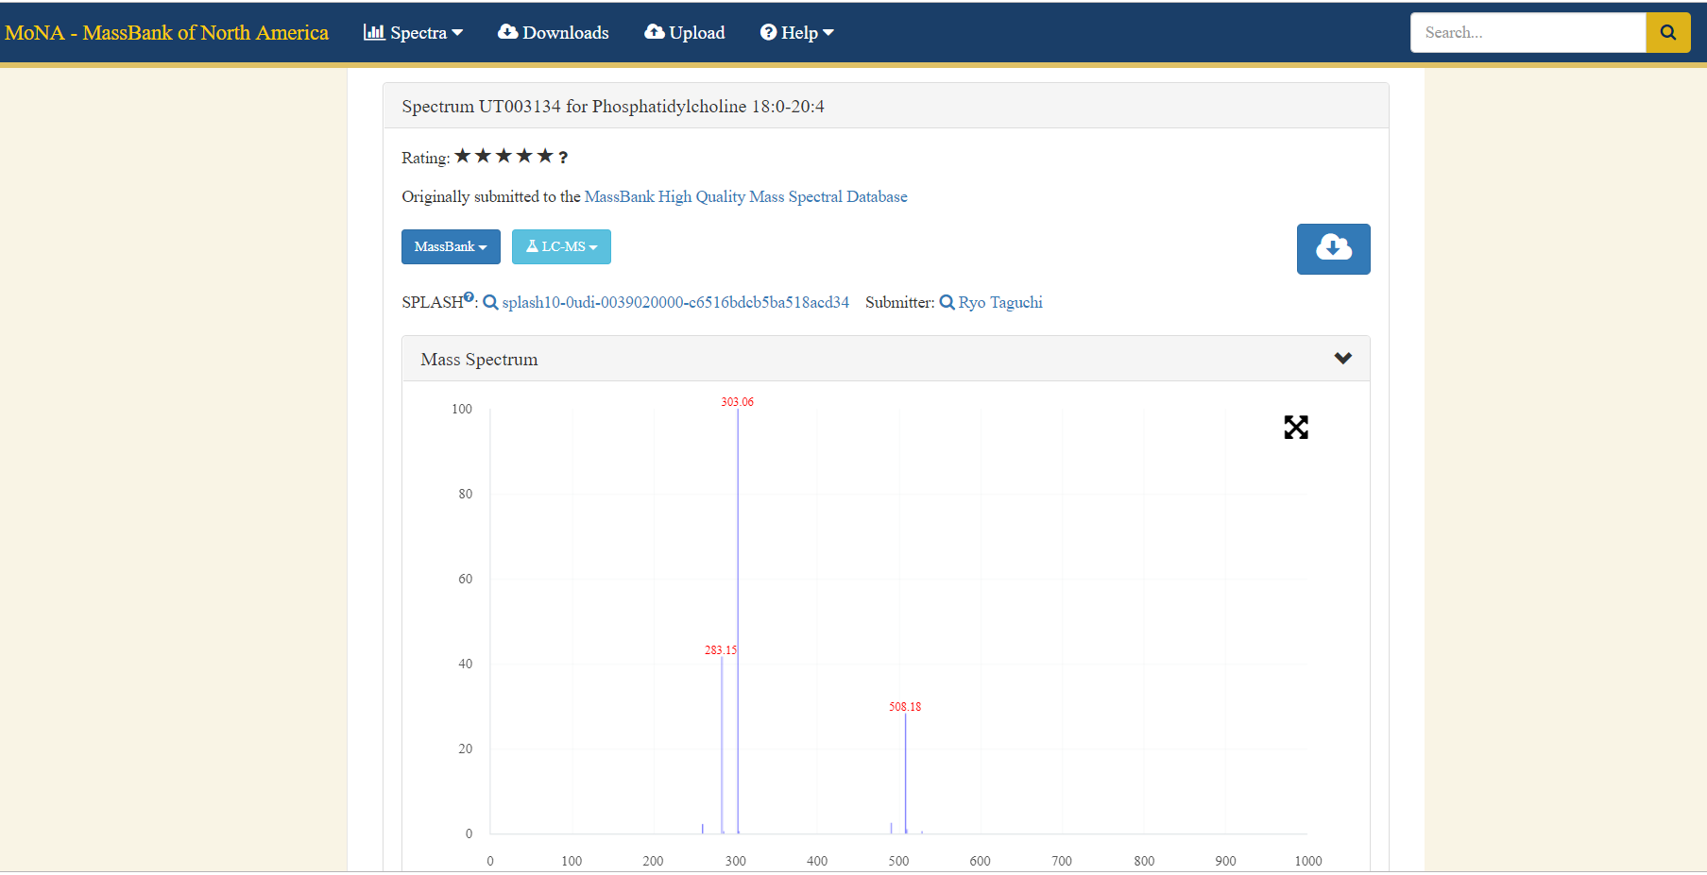
Querying Lipidomics Gateway website as “Quick search”
View MoNA MS Spectra

Slide 40
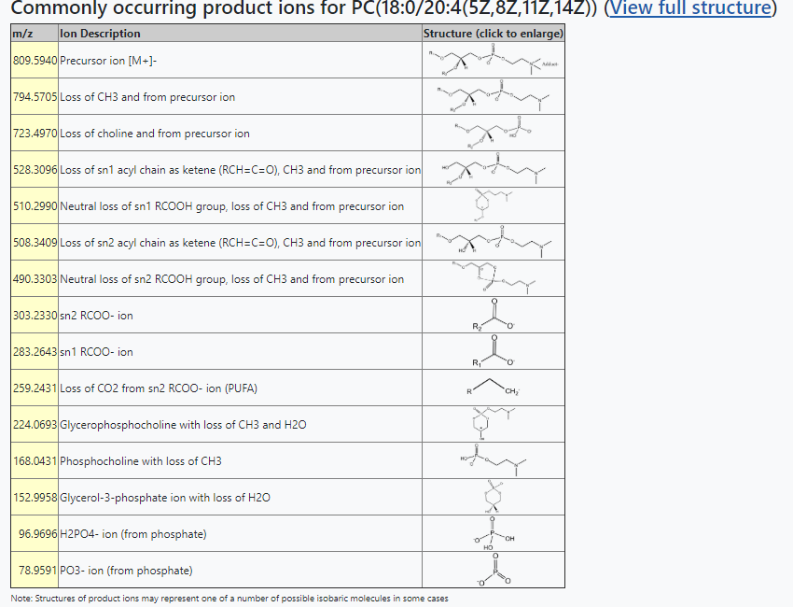
Querying Lipidomics Gateway website as “Quick search”
Predict MS/MS spectrum
(Neg. Mode)

Slide 41
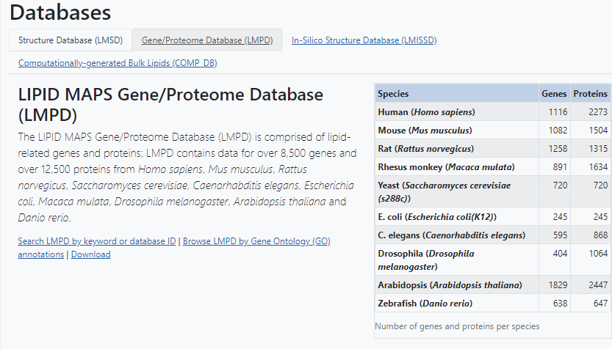
Databases: LIPID MAPS Gene/Proteome Database (LMPD)

Slide 42
LMPD: Data collection strategy
Lipid-related keywords in gene names, metabolic pathways and ontology terms
Manual curation
Entrez Gene ID list
Python
program
NCBI Entrez
UniProt
Gene, mRNA, protein data, PTM variants, motifs, homologs, cross-references, related proteins, ontologies, annotations, etc.
LMPD Gene/Proteome database

Slide 43
LMPD organization:
Gene-> mRNA-> (apo)protein -> mature protein
Entrez Gene ID (DNA/genomic links)
RefSeq mRNA ID’s (both coding and UTR variants)
RefSeq protein ID’s and sequences (unique isoforms)
Post–translationally modified variants (e.g. apo-, mature forms, leader sequences, etc.)

Slide 44
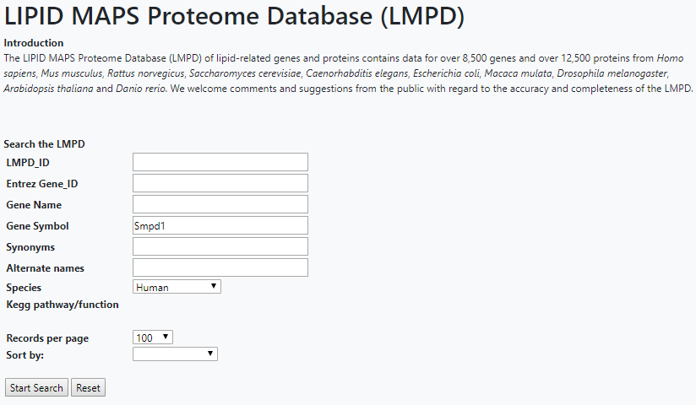
Databases: LIPID MAPS Proteome Database (LMPD)

Slide 45
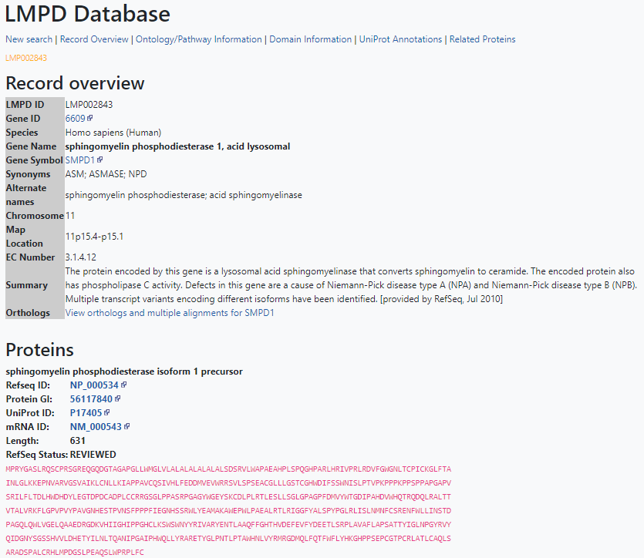

Databases: LIPID MAPS Proteome Database (LMPD)

Slide 46



Databases: LIPID MAPS Proteome Database (LMPD)

Slide 47

Databases: In-Silico Structure Database (LMISSD)

Slide 48





Databases: In-Silico Structure Database (LMISSD)

Slide 49

Pathways
http://www.lipidmaps.org/resources/pathways/index.php
Resources →Pathways

Slide 50

Pathways: Maps drawn using Vanted Software
http://www.lipidmaps.org/resources/pathways/vanted.php
RAW 264.7 cells:
- Kdo₂-Lipid A
- Compactin/Kdo₂-Lipid A
- POVPC/ATP
Thioglycolate-elicited peritoneal macrophages
- Compactin/Kdo₂-Lipid A
Bone marrow-derived macrophages:
-ATP/Kdo₂-Lipid A (pmol/ug DNA) [Averaged DNA values]
-25-hydroxy-cholesterol (pmol/sample)

Slide 51


Slide 52

Tools: MS Analysis
http://www.lipidmaps.org/resources/tools/index.php
Resources →Tools → MS analysis→Multiple lipid classes→Calculate exact mass.
Calculate the exact mass of a lipid
(Display structure (save as molfile) and isotopic distribution profile)

Slide 53



Tools: MS Analysis

Slide 54


Tools: MS Analysis
http://www.lipidmaps.org/resources/tools/index.php?tab=ms
103.1123 | Negative
173.2481 | Negative
210.1853 | Negative
250.1778 | Negative
303.3046 | Negative
371.2766 | Negative
537.4129 | Negative
647.5225 | Negative
752.4064 | Negative
822.6082 | Negative
914.5855 | Negative
1155.725 | Negative
1532.124 | Negative
1790.535 | Negative
Default values
115.9209 | Positive
284.2673 | Positive
364.3583 | Positive
387.0259 | Positive
413.3463 | Positive
459.3267 | Positive
466.3098 | Positive
528.2728 | Positive
699.5159 | Positive
834.6591 | Positive
916.5563 | Positive
1690.407 | Positive

Slide 55



Tools: Bulk Searches
http://www.lipidmaps.org/resources/tools/bulk_structure_searches.php?database=LMSD

Slide 56



Tools: Bulk Searches
http://www.lipidmaps.org/resources/tools/bulk_structure_searches.php?database=LMSD

Slide 57


Tools: MS Analysis
http://www.lipidmaps.org/tools/ms/LMSD_search_mass_options.php
Resources →Tools → MS analysis→Multiple lipid classes→Search LMSD for curated and/or computationally-generated lipids

Slide 58


Tools: MS Analysis
http://www.lipidmaps.org/tools/ms/kendrick_form.php
Resources →Tools → MS analysis→Multiple lipid classes→Calculate referenced Kendrick mass defect analysis for high-resolution MS data

Slide 59

Tools: MS Analysis
http://www.lipidmaps.org/resources/tools/index.php
Resources →Tools → MS analysis→Glycerophospholipids→Search a computationally-generated database of glycerophospholipid “bulk” masses

Slide 60

Tools: MS Analysis
http://www.lipidmaps.org/tools/ms/glycerophospholipids_batch_bulk.html
Resources →Tools → MS analysis→Glycerophospholipids→Search a computationally-generated database of glycerophospholipid “bulk” masses
Original orbitrap data: m/z and peak area
141.017 | 32112405
319.2275 | 21964531
530.4654 | 29482535
723.5151 | 35981476
748.5275 | 47306288
750.5433 | 1.54E+08
750.5435 | 25623116
818.5906 | 57360932
819.5936 | 28125851
871.6901 | 42833435
1175.775 | 20417328

Slide 61


Tools: MS Analysis
http://www.lipidmaps.org/tools/ms/glycerophospholipids_batch_bulk.html
Resources →Tools → MS analysis→Glycerophospholipids→Search a computationally-generated database of bulk glycerophospholipids

Slide 62

Tools: MS Analysis
http://www.lipidmaps.org/tools/ms/gp_ox_form.php
Resources →Tools → MS analysis→Glycerophospholipids→Search a computationally-generated database of oxidized glycerophospholipids
67 different oxidized chain species at sn2 position derived from C18,C20 and C22 precursors

Slide 63

Tools: MS Analysis
http://www.lipidmaps.org/tools/ms/gp_ox_form.php
Resources →Tools → MS analysis→Glycerophospholipids→Search a computationally-generated database of oxidized glycerophospholipids
mzmed
339.3445
374.3059
374.306
376.3194
376.3194
376.3207
390.2998
392.3135
393.3169
495.2999
551.3289
627.5388
644.5955
648.4621
665.4603
670.6111
672.6268
680.4805
728.5205
746.6069
754.5362
760.6415
768.5595
785.6538
788.6718
795.617
796.6217
809.5882
811.6687
812.5439
812.5439
812.6137
812.6165
813.6199
813.6844
814.6876
815.6992
827.7105
855.7416
856.7449
881.7571
Original orbitrap data: m/z and peak area

Slide 64

Tools: MS Analysis
http://www.lipidmaps.org/tools/ms/gp_ox_form.php
Resources →Tools → MS analysis→Glycerophospholipids→Search a computationally-generated database of oxidized glycerophospholipids

Slide 65

Tools: Structure drawing
http://www.lipidmaps.org/resources/tools/index.php?tab=structure

Slide 66




Tools: Structure drawing
http://www.lipidmaps.org/resources/tools/index.php?tab=structure

Slide 67


Tools: Structure drawing
http://www.lipidmaps.org/resources/tools/index.php?tab=structure

Slide 68

Tools: Statistical Analysis
http://www.lipidmaps.org/resources/tools/index.php?tab=stats

Slide 69


Tools: Statistical Analysis
http://www.lipidmaps.org/resources/tools/index.php?tab=stats

Slide 70




Tools for Statistical analysis: output

Slide 71

Volcano plot: pairwise comparison of 2 experimental conditions

Slide 72

Tools: Software: LipidFinder
http://www.lipidmaps.org/resources/tools/index.php
Search for high
resolution MS
raw data

Slide 73

Tools: Software: LipidFinder
http://www.lipidmaps.org/data/LF/

Slide 74

Tools: Software: LipidFinder
http://www.lipidmaps.org/data/LF/data_selection.php?id=R49NcxjKTOwtsCG3

Slide 75


Tools: LipidFinder peak filter

Slide 76

Tools: Software: LipidFinder
http://www.lipidmaps.org/data/LF/data_selection.php?id=R49NcxjKTOwtsCG3

Slide 77

Tools: Software: LipidFinder
http://www.lipidmaps.org/data/LF/data_selection.php?id=R49NcxjKTOwtsCG3

Slide 78


Tools: Software: LipidFinder
http://www.lipidmaps.org/data/LF/data_selection.php?id=R49NcxjKTOwtsCG3

Slide 79





Tools: Software: LipidFinder
http://www.lipidmaps.org/data/LF/peak_filter_status.php?id=R49NcxjKTOwtsCG3

Slide 80


Tools: Software: LipidFinder
http://www.lipidmaps.org/data/LF/peak_filter_status.php?id=R49NcxjKTOwtsCG3

Slide 81


Tools: Software: LipidFinder
http://www.lipidmaps.org/data/LF/peak_filter_status.php?id=R49NcxjKTOwtsCG3

Slide 82

Tools: Software: LipidFinder
https://github.com/ODonnell-Lipidomics/LipidFinder

Slide 83

Tools: Software: LipidFinder
https://github.com/ODonnell-Lipidomics/LipidFinder/tree/master/User%20guides

Slide 84


Tools: Software: LipidFinder
https://github.com/ODonnell-Lipidomics/LipidFinder/blob/master/User%20guides/PeakFilter_Input_file_preparation_guide.docx

Slide 85

Tools: Software: LipidFinder
http://www.lipidmaps.org/resources/tools/index.php?tab=software

Slide 86
















Tools: External Software
http://www.lipidmaps.org/resources/tools/index.php?tab=software
http://genome.tugraz.at/lda/lda_description.shtml

Slide 87






Acknowledgements
Cardiff University
  Valerie O’Donnell (PI)
  Caroline Jeffs
  Jorge Alvarez-Jarreta
  Robert Andrews
Babraham Institute
  Michael Wakelam(PI)
  Simon Andrews
  An Nguyen
University of California San Diego
  Eoin Fahi (PI)
  Dawn Cotter

